Slide 1
CSE 4000A: Final Year Design Project
Group [C-5]
Group members
Nafisa Yeasmin Tonni ID - 011151047
MD. Rezuanur Rafy ID - 011151352
Imran Khan ID - 011151075
Beauty Akter ID - 011151045

Slide 2


Supervisor :
Class Teacher
Md. Saddam Hossain Mukta
Assistant Professor.
Suman Ahmmed
Assistant Professor ,Director of CDIP.

Slide 3
Topic
Web Based Investment Finding System

Slide 4
Agenda/Topics to Be Covered
Problem statements
The Big Picture
Problem Motivations
Benchmark
Project Features
System Architecture Design
Demonstration
Literature Review
Project Methodology
Standards and impacts
Future Plan

Slide 5
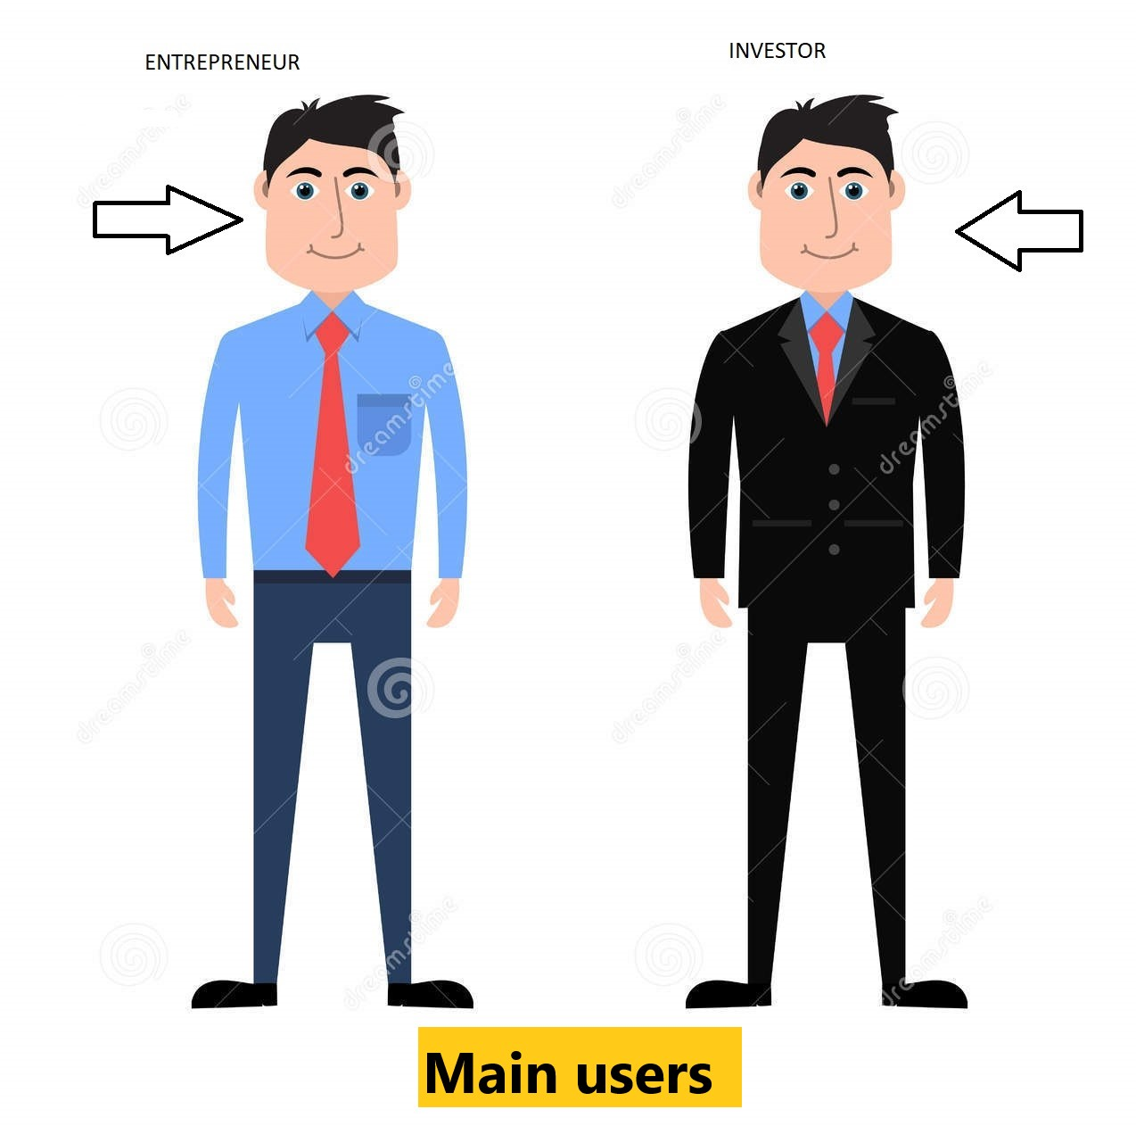


Problem Statement
Problem with entrepreneurs and investors
Entrepreneurs are facing problem to get investment
Investors are not finding good projects to invest

Slide 6






The Big Picture

Slide 7



Problem Motivations
Helping entrepreneurs and investors
Difficulties to get loan from bank
Getting no update from each other
Lack of website based platform.

Slide 8





Benchmark

Slide 9





Project Features
1.personal profile
2.company’s profile
3.Finding each-other
4.Security
5.Payment
6.Contact advisor

Slide 10
System Architecture Design

Slide 11
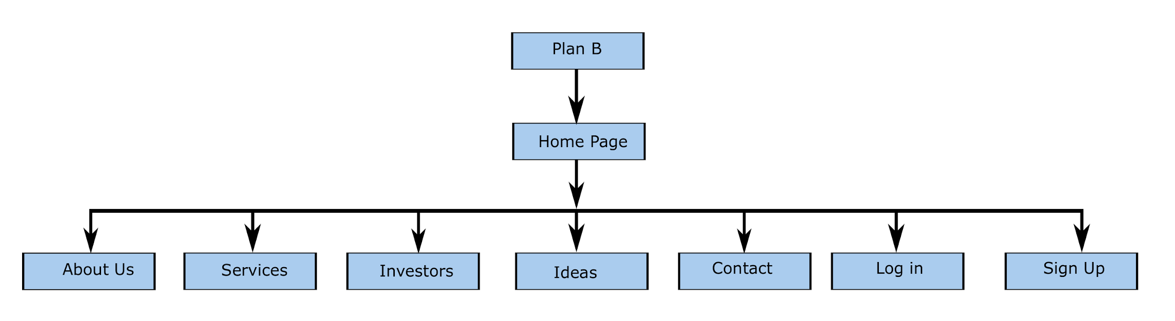
WebSite Home Page

Slide 12
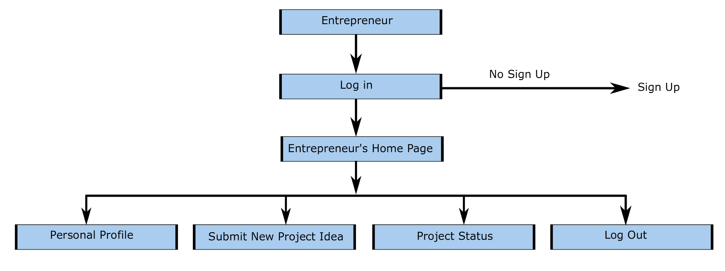
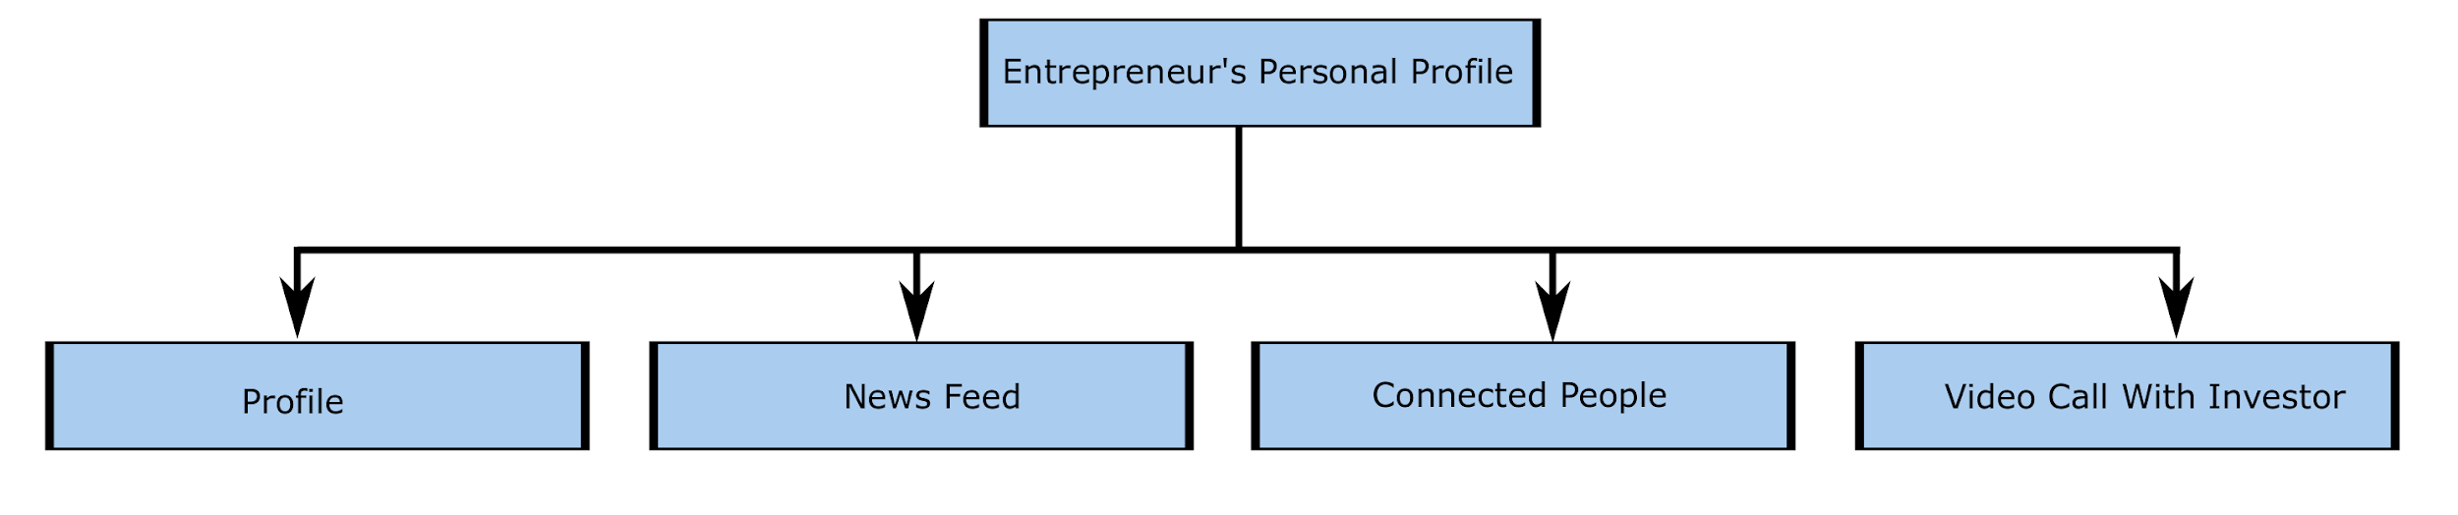
Entrepreneur’s home page
Entrepreneur’s personal profile

Slide 13

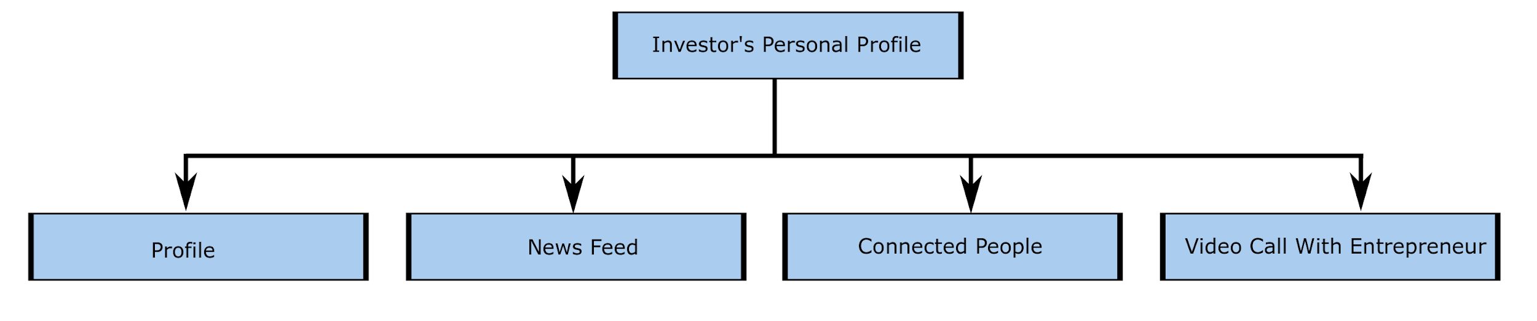
Investor’s home page
Investor’s personal profile

Slide 14
Demonstration

Slide 15
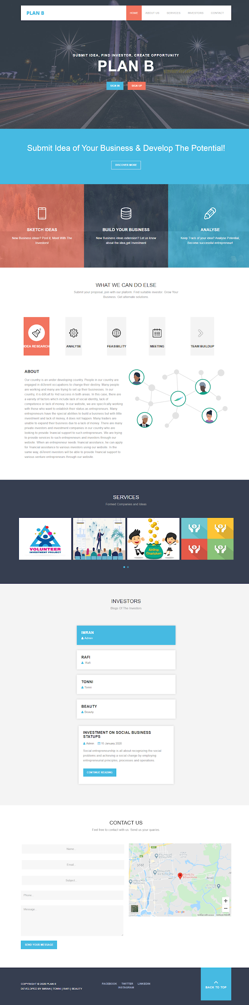
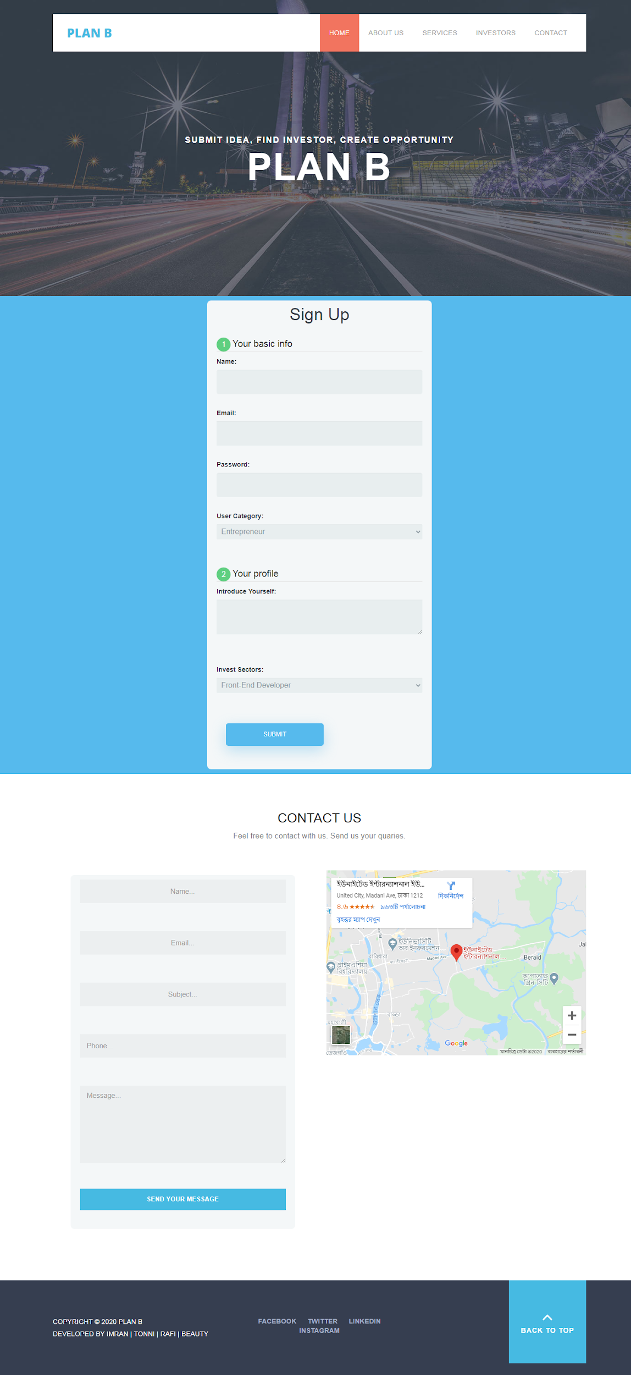
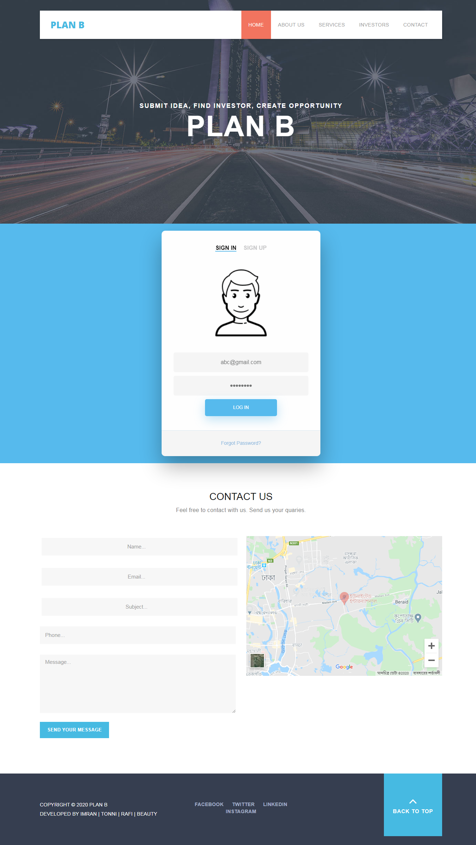
Home Page
Sign up
Sign in

Slide 16
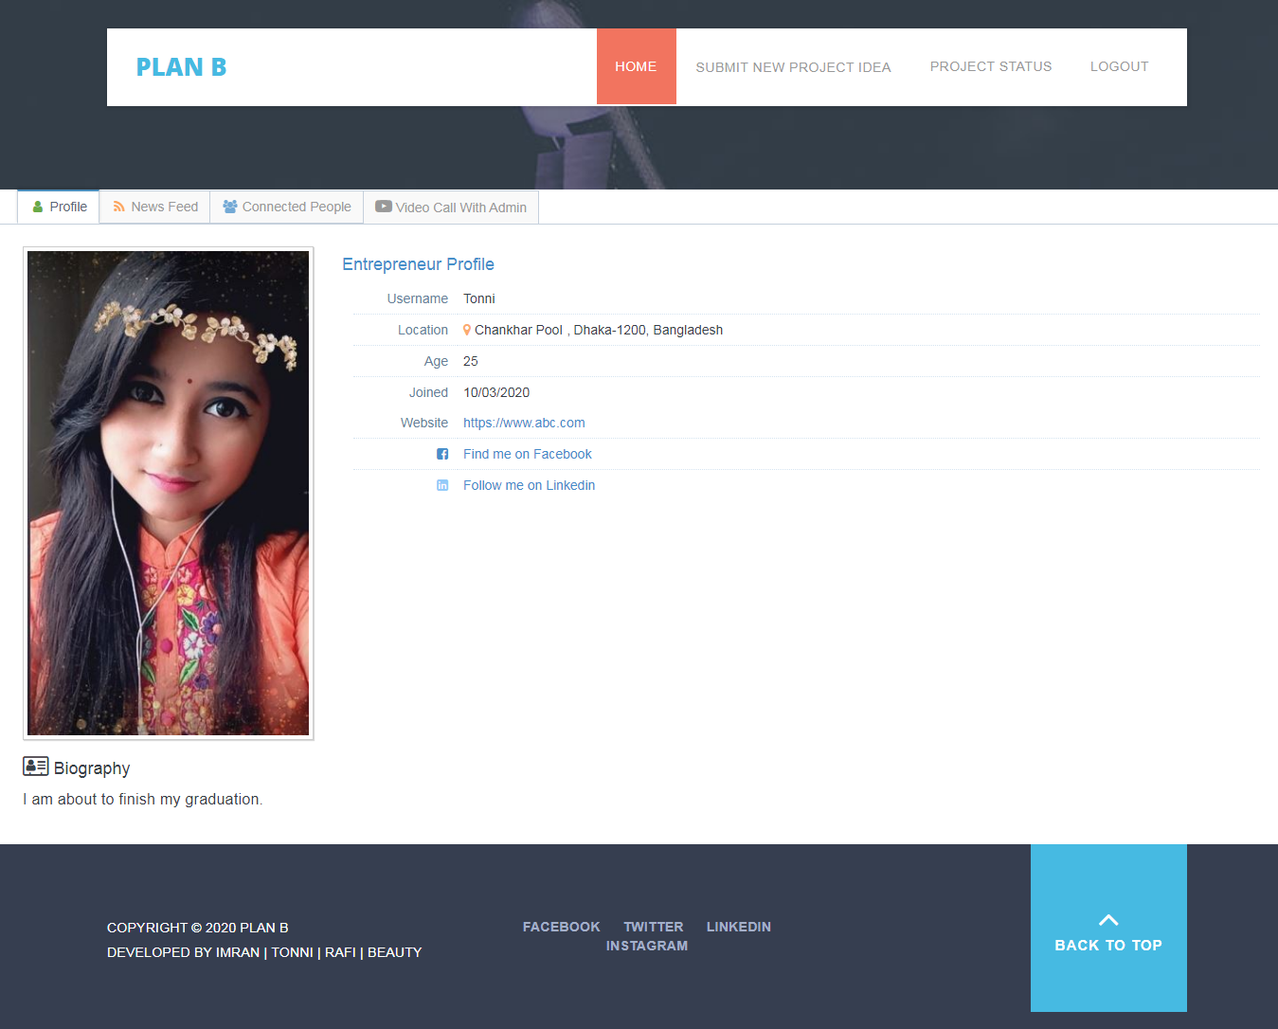
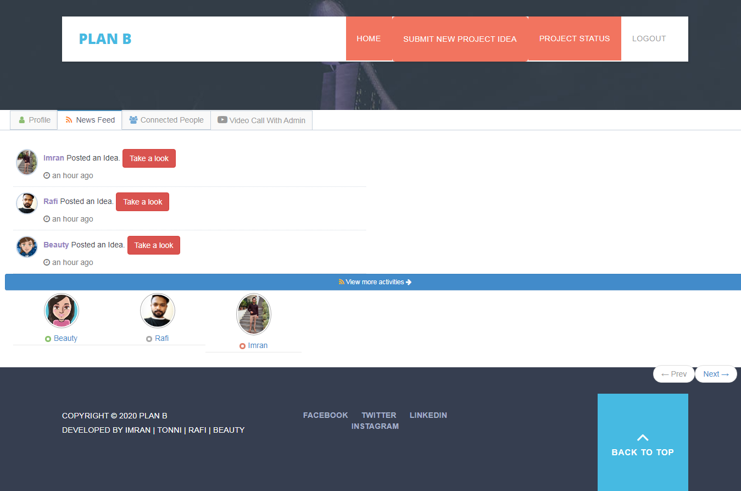
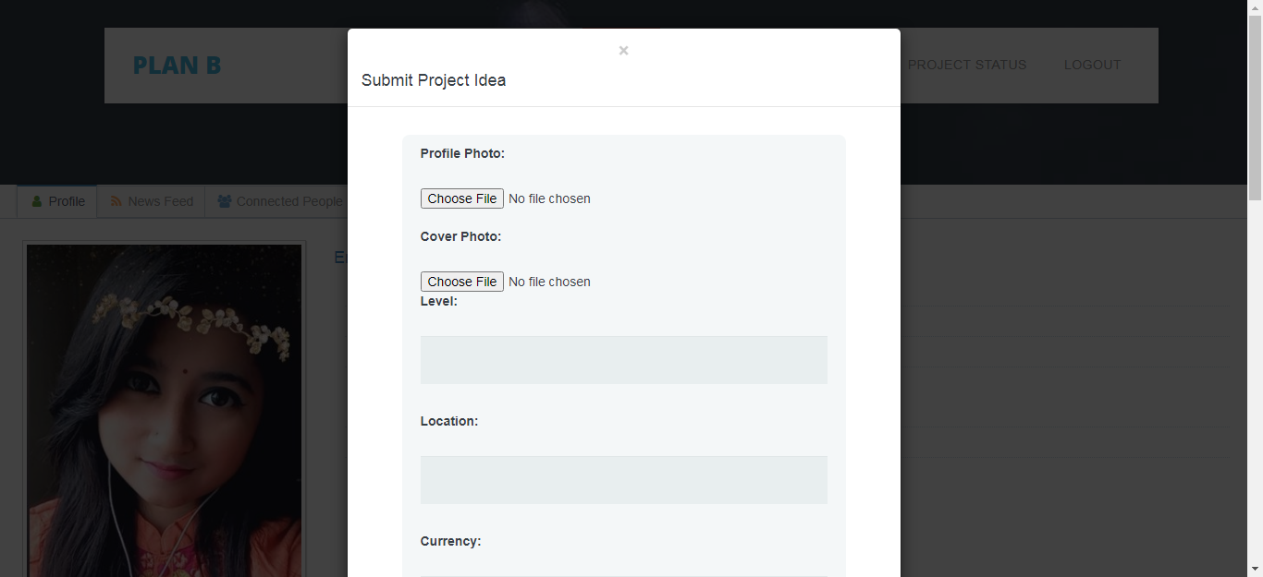
Personal profile
News feed
Submit project idea

Slide 17
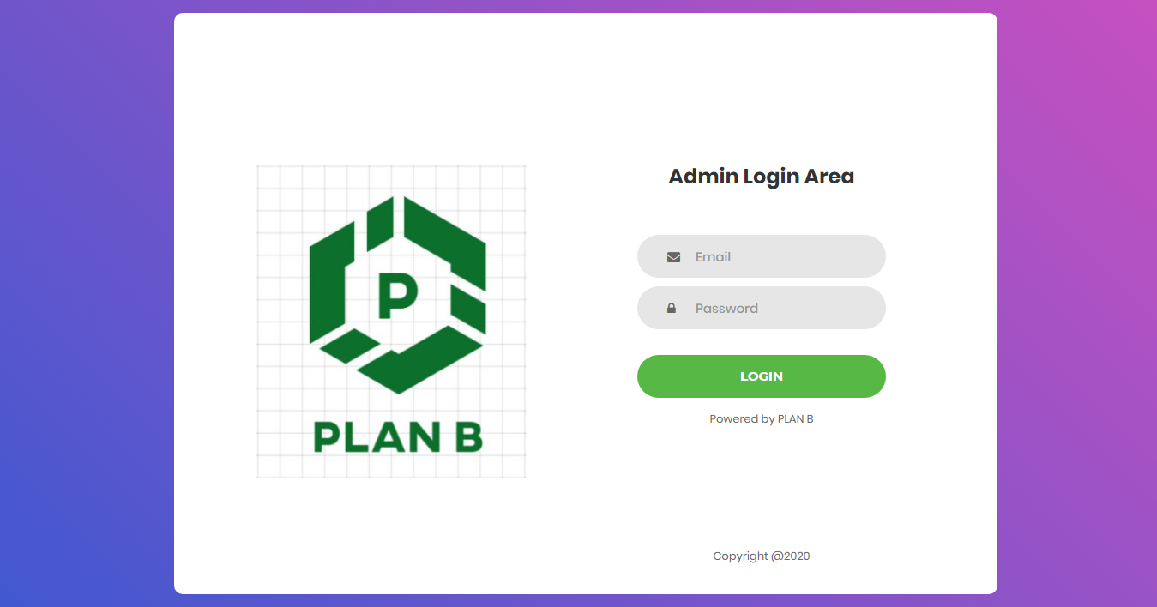
Admin Panel

Slide 18
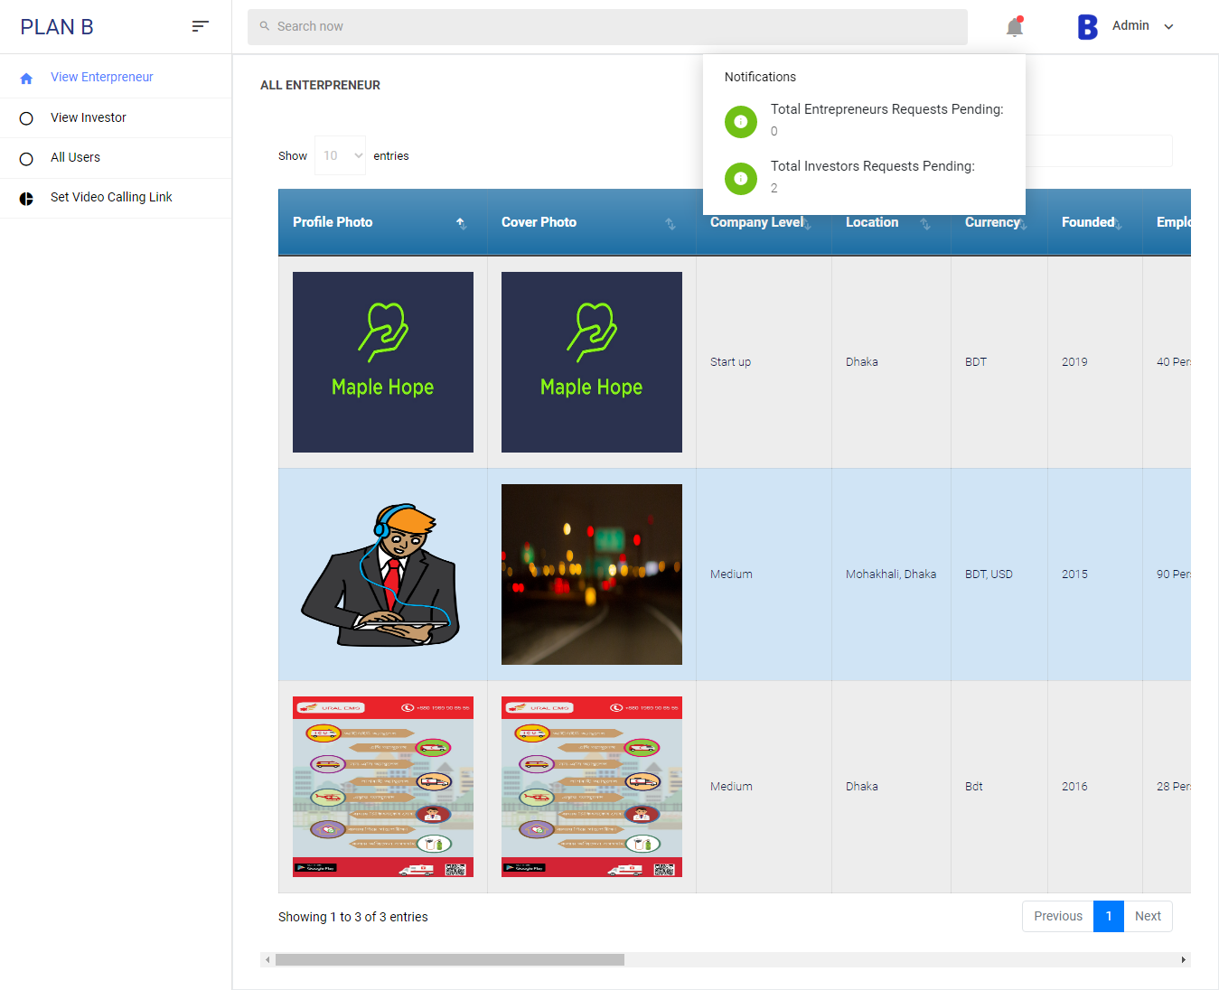
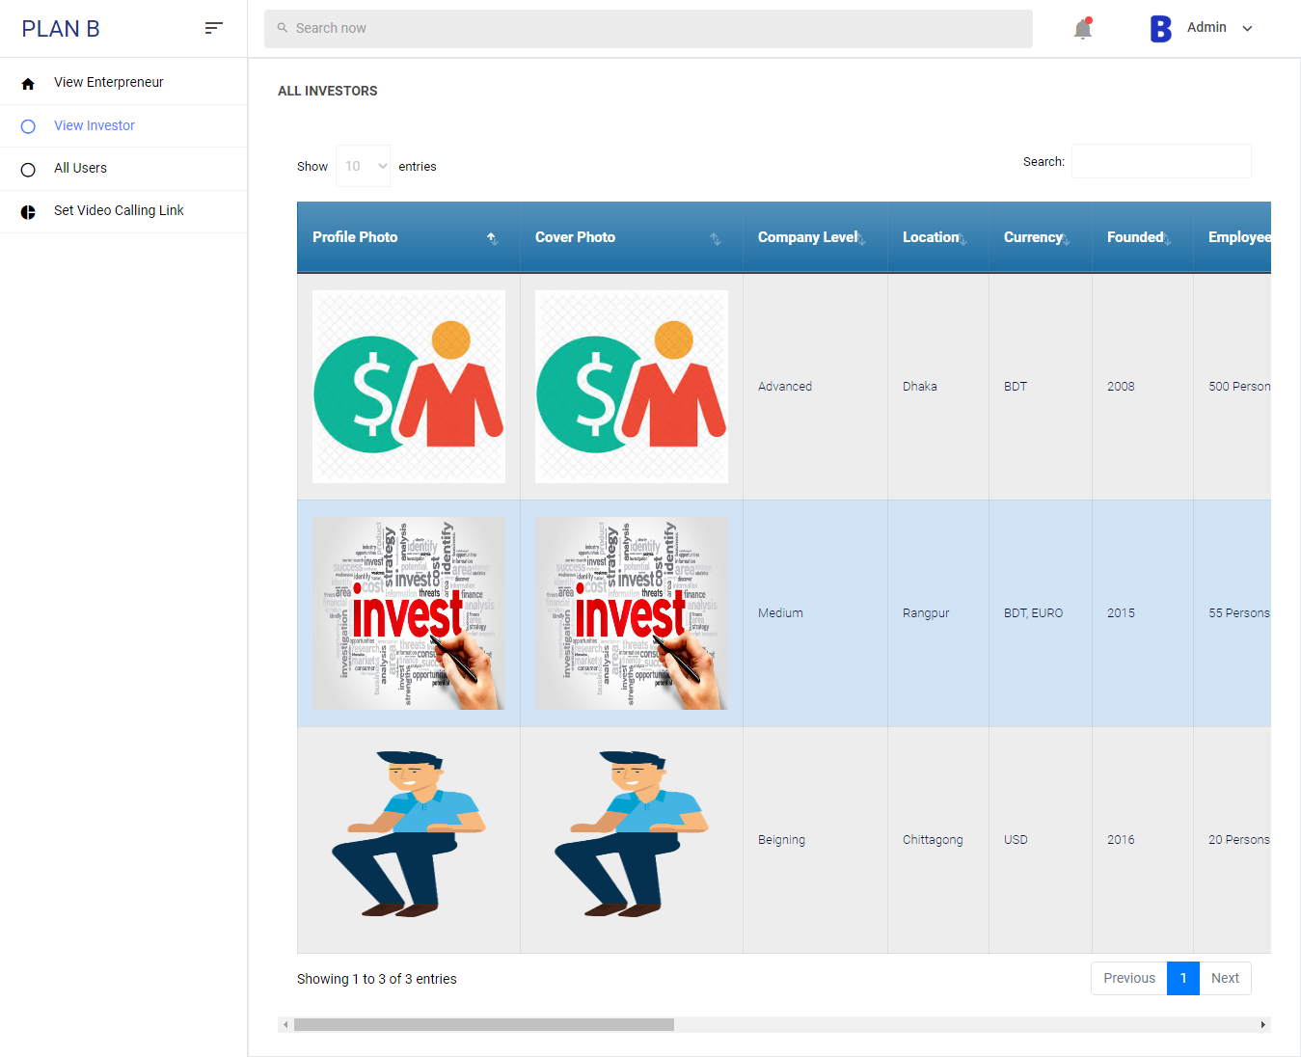
View entrepreneurs
View investors

Slide 19
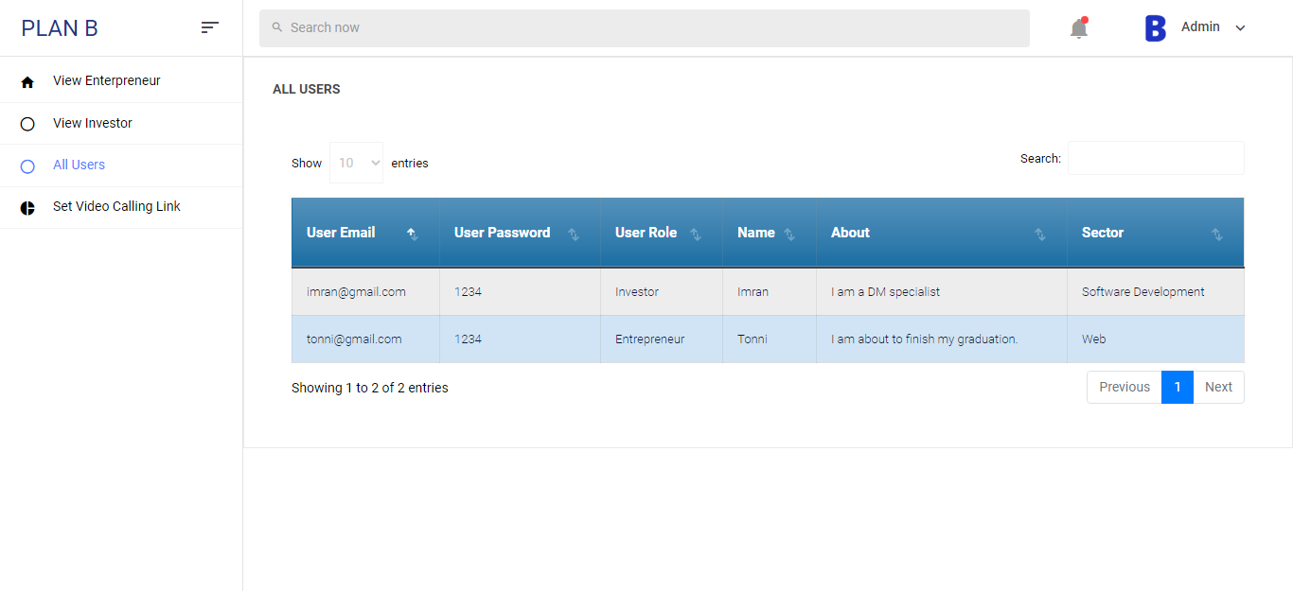
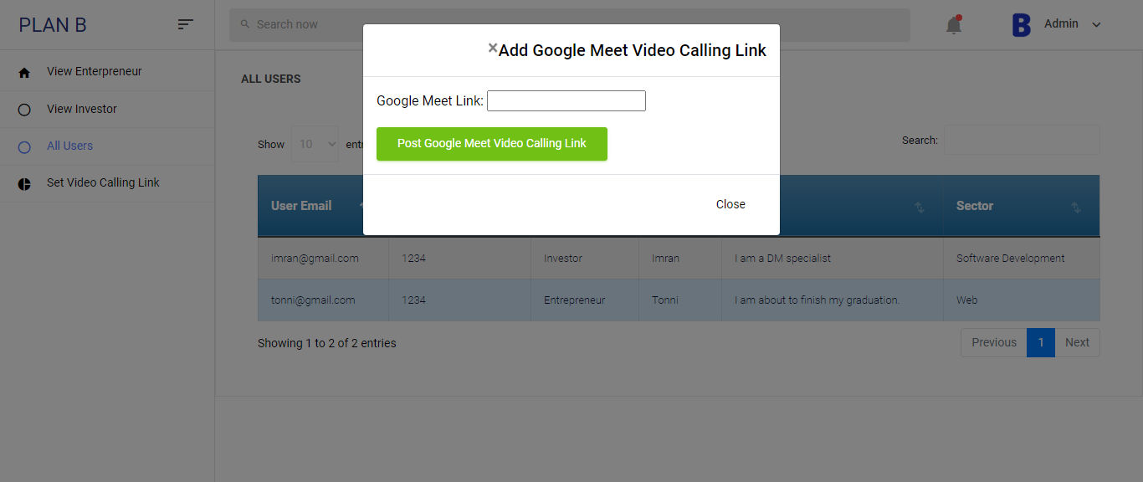
All users
Set video call

Slide 20
Literature review

Slide 21
Literature review
Paper Information | Contribution | Differences or Relations
Angel investment criteria, Sudek et al, 2016.[1] | The capital requirements and investor proper investment are discussed. | We will implement how an investor can easily invest in an entrepreneur on our website.
Investment criteria set by venture capitalists, Marija et al, 2015. [2] | Determine the correct and acceptable criteria for a safe investment. | Entrepreneurs create profiles with credible information so it is safe for investors to invest.
A comparative analysis of cross-platform development approaches for mobile applications, Xanthopoulos et al, 2013.[3] | Developing cross-platform mobile apps. | Our topic is cross platform related we are developing websites in place of mobile apps.

Slide 22
Literature review continue
Paper Information | Contribution | Differences or Relations
The role of gender in entrepreneur-investor relationships, Gry Agnete Alsos et al, 2017.[4] | Gender issues related to the signaler and the receiver that influence received signals. | We will guarantee that no gender discrimination will be available for access to the service on our website.
Why business angels reject investment opportunities, Mason et al, 2017.[5] | Entrepreneurial finance, business angels, angel characteristics, investment decision, rejection. | Our website will provide information on various types of entrepreneurs and investors.
Trust, investment, and business contracting, Ang et al, 2015.[6] | Role of trustworthiness in corporate decisions. | Website authorities will ensure that every information is credible to entrepreneurs and investors.

Slide 23
Literature review continue
Paper Information | Contribution | Differences or Relations
Government policy and private investment in developing countries, Blejer et al, 2016.[7] | Impact of private investment in a developing country | If an individual wants to invest in an entrepreneur personally, he can give it through our website
Investor motivations in investment-based crowdfunding,Fabrice et al, 2016.[8] | Investment decisions and campaign outcomes in investment-based crowdfunding are affected by gender difference. | There will be no gender differences on our website.
The Examination of Financial Knowledge-Acquiring Behaviour of People in General to Develop Websites, Ubonsan et al, 2019.[10] | Determining the behavior of website users and provides expected results | Our website's features will be arranged according to the user's investment related expectation.

Slide 24
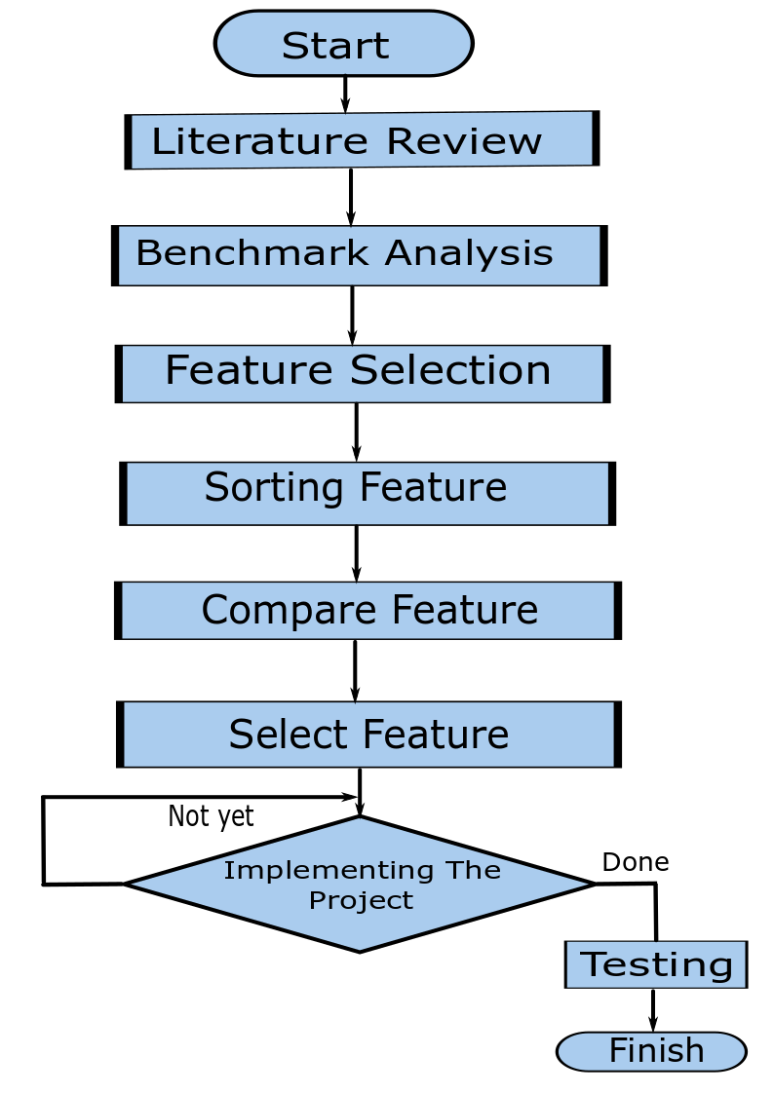
Project Methodology

Slide 25
Standards And Impacts

Slide 26



Standards
1.Technological Standard
2.Ethical standard
PCI Compliance
IEEE/ACM code of ethics
Trade-marks Act
3.Safety Standard

Slide 27



Impacts
Economic Impact
Ethical Impact
Social Impact

Slide 28
Future Plan
Tax number checking
Developing our API
Online payment services
Building a mobile friendly application
Giving market update
Application of AI

Slide 29
References
[1] Richard Sudek., Angel investment criteria.Journal of Small Business Strategy, 2016.
[2] Marija et al.,Investment criteria set by venture capitalists.Ekonomski vjesnik/econviews: Review of contemporary business, entrepreneurship and economic issues
, 2015
[3] Spyros Xanthopoulos and Stelios Xinogalos. A comparative analysis of cross-platform
development approaches for mobile applications. 2013
[4] Gry Agnete Alsos and Elisabet Ljunggren. The role of gender in entrepreneur–investor
relationships: A signaling theory approach.Entrepreneurship Theory and Practice,2017.
[5] Colin Mason, Tiago Botelho, and Justyna Zygmunt. Why business angels reject
investment opportunities: Is it personal?International Small Business Journal, 2017.
[6] James S Ang, Yingmei Cheng, and Chaopeng Wu. Trust, investment, and business
Contracting. Journal of Financial and Quantitative Analysis, 2015.
[7] Mario I Blejer and Mohsin S Khan. Government policy and private investment in
developing countries.Staff Papers, 2016.
[8] Fabrice Herv ́e, Elodie Manth ́e, Aur ́elie Sannajust, Armin Schwienbacher, et al. In-
vestor motivations in investment-based crowdfunding. Available at SSRN 2746398, 2016.
[10] Penprapa Ubonsan and Jongrak Hong-ngam. The examination of financial knowledge-
acquiring behaviour of people in general to develop websites: A case study of imoney.
in. th.Review of Integrative Business and Economics Research, 2019.

Slide 30


